Slide 1
AI I: problem-solving and search
Original Slides by: Tom Lenaerts
Institut de Recherches Interdisciplinaires et de Développements en Intelligence Artificielle (IRIDIA)
Université Libre de Bruxelles
Adapted for Edinburgh Napier by Ben Paechter

Slide 2
Outline
Problem-solving agents
  A particular kind of goal-based agent
Problem formulation
  Example problems
Basic search algorithms
  Uninformed Search (Informed Search next week)
Original Slides by Tom Lenaerts – IRIDIA ULB
Adapted for Edinburgh Napier by Ben Paechter

Slide 3
Problem-solving agent
Four general steps in problem solving:
  Goal formulation
    What are the successful world states
  Problem formulation
    What actions and states to consider given the goal
  Search
    Determine the possible sequence of actions that lead to the goal states - and then choosing the best sequence.
  Execute
    Given the solution, perform the actions.
Original Slides by Tom Lenaerts – IRIDIA ULB
Adapted for Edinburgh Napier by Ben Paechter

Slide 4
Problem-solving agent
function SIMPLE-PROBLEM-SOLVING-AGENT(percept) return an action
static: seq, an action sequence
state, some description of the current world state
goal, a goal
problem, a problem formulation
state ← UPDATE-STATE(state, percept)
if seq is empty then (no actions planned)
goal ← FORMULATE-GOAL(state)
problem ← FORMULATE-PROBLEM(state, goal)
seq ← SEARCH(problem)
action ← FIRST(seq)
seq ← REST(seq)
return action
Original Slides by Tom Lenaerts – IRIDIA ULB
Adapted for Edinburgh Napier by Ben Paechter

Slide 5
Example: Romania
On holiday in Romania; currently in Arad
  Flight leaves tomorrow from Bucharest
Formulate goal
  Be in Bucharest
Formulate problem
  States: various cities
  Actions: drive between cities
Find solution
  Sequence of cities; e.g. Arad, Sibiu, Fagaras, Bucharest, …
Abstraction – get things at the right level of detail
Original Slides by Tom Lenaerts – IRIDIA ULB
Adapted for Edinburgh Napier by Ben Paechter

Slide 6
Selecting a state space
Real world is absurdly complex.
  State space must be abstracted for problem solving.
(Abstract) state = set of real states.
(Abstract) action = complex combination of real actions.
  e.g. Arad →Zerind represents a complex set of possible routes, detours, rest stops, etc.
  The abstraction is valid if the path between two states is reflected in the real world.
(Abstract) solution = set of real paths that are solutions in the real world.
Each abstract action should be “easier” than the real problem.
Original Slides by Tom Lenaerts – IRIDIA ULB
Adapted for Edinburgh Napier by Ben Paechter

Slide 7
Problem formulation
A problem is defined by:
  An initial state, e.g. Arad
  Successor function S(X)= set of action-state pairs
    e.g. S(Arad)={<Arad → Zerind, Zerind>,…}
  intial state + successor function = state space
  Goal test, can be
    Explicit, e.g. x=‘at bucharest’
    Implicit, e.g. checkmate(x)
  Path cost (additive)
    e.g. sum of distances, number of actions executed, …
    c(x,a,y) is the step cost, assumed to be >= 0
  A solution is a sequence of actions from initial to goal state.
  Optimal solution has the lowest path cost.
Original Slides by Tom Lenaerts – IRIDIA ULB
Adapted for Edinburgh Napier by Ben Paechter

Slide 8

Toy Example: vacuum world
States??
Initial state??
Actions??
Goal test??
Path cost??
Original Slides by Tom Lenaerts – IRIDIA ULB
Adapted for Edinburgh Napier by Ben Paechter

Slide 9
Toy Example: vacuum world
States?? two locations with or without dirt: 2 x 2²=8 states.
Initial state?? Any state can be initial
Actions?? {Left, Right, Suck}
Goal test?? Check whether all squares are clean.
Path cost?? Number of actions to reach goal.
Original Slides by Tom Lenaerts – IRIDIA ULB
Adapted for Edinburgh Napier by Ben Paechter

Slide 10

Toy Example: 8-puzzle
Rearrange the squares so until you get to the goal state by repeatedly moving tiles into the free space.
Original Slides by Tom Lenaerts – IRIDIA ULB
Adapted for Edinburgh Napier by Ben Paechter

Slide 11
Toy Example: 8-puzzle
States??
Initial state??
Actions??
Goal test??
Path cost??
Original Slides by Tom Lenaerts – IRIDIA ULB
Adapted for Edinburgh Napier by Ben Paechter

Slide 12
Toy Example: 8-puzzle
States?? Integer location of each tile
Initial state?? Any state can be initial
Actions?? {Left, Right, Up, Down}
Goal test?? Check whether goal configuration is reached
Path cost?? Number of actions to reach goal
Original Slides by Tom Lenaerts – IRIDIA ULB
Adapted for Edinburgh Napier by Ben Paechter

Slide 13
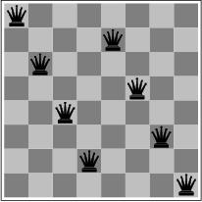
Toy Example: 8-queens problem
Arrange 8 queens on a board so that no queen is attacking any other queen (queens attack along horizontal, vertical or diagonal lines).
Original Slides by Tom Lenaerts – IRIDIA ULB
Adapted for Edinburgh Napier by Ben Paechter

Slide 14
Toy Example: 8-queens problem
Arrange 8 queens on a board so that no queen is attacking any other queen (queens attack along horizontal, vertical or diagonal lines).
Original Slides by Tom Lenaerts – IRIDIA ULB
Adapted for Edinburgh Napier by Ben Paechter

Slide 15
Toy Example: 8-queens problem
Arrange 8 queens on a board so that no queen is attacking any other queen (queens attack along horizontal, vertical or diagonal lines).
Complete-state formulation vs. incremental formulation
  In the complete-state formulation of the problem there are eight queens already on the board and they have to be re-arranged
  In the incremental version the queens are added one at a time
Original Slides by Tom Lenaerts – IRIDIA ULB
Adapted for Edinburgh Napier by Ben Paechter

Slide 16
Toy Example: 8-queens problem
States??
Initial state??
Actions??
Goal test??
Path cost??
Original Slides by Tom Lenaerts – IRIDIA ULB
Adapted for Edinburgh Napier by Ben Paechter

Slide 17
Toy Example: 8-queens problem
Incremental formulation (first version)
States?? Any arrangement of 0 to 8 queens on the board
Initial state?? No queens
Actions?? Add queen in empty square
Goal test?? 8 queens on board and none attacked
Path cost?? None
3 x 10¹⁴ possible sequences to investigate – very large
Original Slides by Tom Lenaerts – IRIDIA ULB
Adapted for Edinburgh Napier by Ben Paechter

Slide 18
Toy Example: 8-queens problem
Incremental formulation (alternative)
States?? All possible arrangements of n (0≤ n≤ 8) queens on the board, one per column in the n leftmost columns with no queen attacking another.
Actions?? Add queen in leftmost empty column such that is not attacking other queens
Only - 2057 possible sequences to investigate;
If we look at the same problem for 100 queens then this version also doesn’t come to a solution in a reasonable time.
Original Slides by Tom Lenaerts – IRIDIA ULB
Adapted for Edinburgh Napier by Ben Paechter

Slide 19
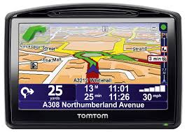
More Real Example: In-car navigation
States??
Initial state??
Actions??
Goal test??
Path cost??
Original Slides by Tom Lenaerts – IRIDIA ULB
Adapted for Edinburgh Napier by Ben Paechter

Slide 20
More Real Example: In-car navigation
States?? All the possible positions within the road network in terms of road segment and position within it
Initial state?? Any state
Actions?? Move from one road segment to another via a junction
Goal test?? Is the current state the destination
Path cost?? Might include the time taken, distance travelled, carbon burnt
Original Slides by Tom Lenaerts – IRIDIA ULB
Adapted for Edinburgh Napier by Ben Paechter

Slide 21
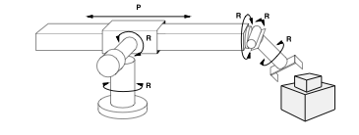
More Real Example: robot assembly
States??
Initial state??
Actions??
Goal test??
Path cost??
Original Slides by Tom Lenaerts – IRIDIA ULB
Adapted for Edinburgh Napier by Ben Paechter

Slide 22
More Real Example: robot assembly
States?? Real-valued coordinates of robot joint angles; parts of the object to be assembled.
Initial state?? Any arm position and object configuration.
Actions?? Continuous motion of robot joints
Goal test?? Complete assembly
Path cost?? Time to execute
Original Slides by Tom Lenaerts – IRIDIA ULB
Adapted for Edinburgh Napier by Ben Paechter

Slide 23
We want to produce
Timetables that work:
  people don’t have to be in two places at once, only one class in a room, room have correct equipment etc.
Timetables which are ‘good’ e.g.
  Students don’t get a single class on a day
  Minimum movement between classes
  Best use of rooms

Slide 24
Building Timetables

Slide 25

More Real Example: Timetabling
States??
Initial state??
Actions??
Goal test??
Path cost??

Slide 26
More Real Example: Timetabling
Assume an incremental method – place one event at a time
States?? All combinations of timetables with n events placed so that they don’t conflict
Initial state?? No events placed
Actions?? Add an event to the timetable so that it doesn’t conflict with previously placed events
Goal test?? Are all the events placed?
Path cost?? How good is the timetable?

Slide 27
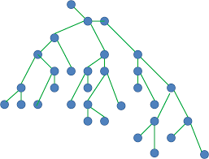
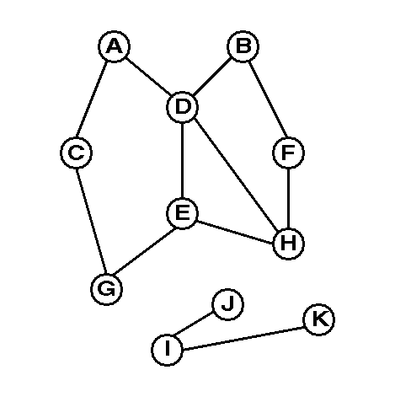
Basic search algorithms
How do we find the solutions of these problems?
  Search the state space (remember complexity of space depends on state representation)
  Here: search through explicit tree generation
    ROOT= initial state.
    Nodes and leafs generated through successor function.
  In general search generates a graph (get to same state through multiple paths). Need to take measures to avoid loops and infinite paths
Original Slides by Tom Lenaerts – IRIDIA ULB
Adapted for Edinburgh Napier by Ben Paechter

Slide 28
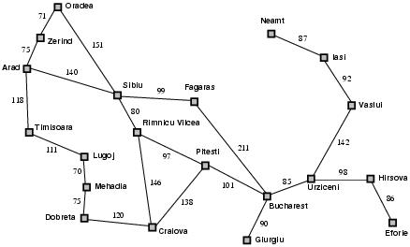
Example: Romania
Original Slides by Tom Lenaerts – IRIDIA ULB
Adapted for Edinburgh Napier by Ben Paechter

Slide 29
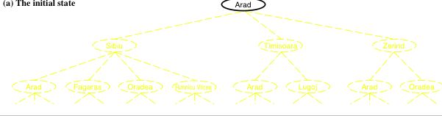
Simple tree search example
function TREE-SEARCH(problem, strategy) return a solution or failure
Initialize frontier to the initial state of the problem
do
if no candidates for expansion then return failure
choose leaf node for expansion according to strategy
if node contains goal state then return solution
expand the node and add resulting nodes to the frontier
enddo
Original Slides by Tom Lenaerts – IRIDIA ULB
Adapted for Edinburgh Napier by Ben Paechter

Slide 30
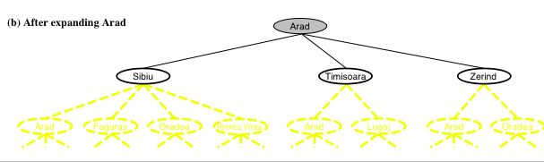
Simple tree search example
function TREE-SEARCH(problem, strategy) return a solution or failure
Initialize frontier to the initial state of the problem
do
if no candidates for expansion then return failure
choose leaf node for expansion according to strategy
if node contains goal state then return solution
expand the node and add resulting nodes to the frontier
enddo
Original Slides by Tom Lenaerts – IRIDIA ULB
Adapted for Edinburgh Napier by Ben Paechter

Slide 31
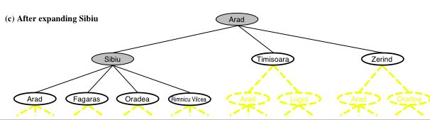
Simple tree search example
function TREE-SEARCH(problem, strategy) return a solution or failure
Initialize frontier to the initial state of the problem
do
if no candidates for expansion then return failure
choose leaf node for expansion according to strategy
if node contains goal state then return solution
expand the node and add resulting nodes to the frontier
enddo
← Determines search process!!
Original Slides by Tom Lenaerts – IRIDIA ULB
Adapted for Edinburgh Napier by Ben Paechter

Slide 32
Graph Search
function GRAPH-SEARCH(problem, strategy) return a solution or failure
Initialize frontier to the initial state of the problem
Initialize the explored set to be empty
do
if no candidates for expansion then return failure
choose leaf node for expansion according to strategy
if node contains goal state then return solution
add the node to the explored set
expand the node and add resulting nodes to the search tree if they are not in the frontier or explored set
enddo
Original Slides by Tom Lenaerts – IRIDIA ULB
Adapted for Edinburgh Napier by Ben Paechter

Slide 33
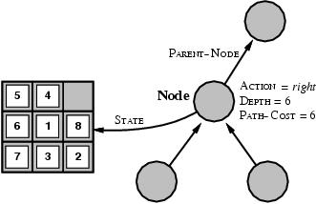
State space vs. search tree
A state is a (representation of) a physical configuration
A node is a data structure belong to a search tree
  A node has a parent, children, … and includes path cost, depth, …
  Here node= <state, parent-node, action, path-cost, depth>
  FRINGE (Frontier, Open List) = contains generated nodes which are not yet expanded.
    White nodes with black outline
Original Slides by Tom Lenaerts – IRIDIA ULB
Adapted for Edinburgh Napier by Ben Paechter

Slide 34
Example: Romania
Original Slides by Tom Lenaerts – IRIDIA ULB
Adapted for Edinburgh Napier by Ben Paechter

Slide 35
Evaluating Search Strategies
A strategy is defined by picking the order of node expansion.
Problem-solving performance is measured in four ways:
  Completeness; Does it always find a solution if one exists?
  Optimality; Does it always find the least-cost solution?
  Time
  Space (Memory)
Original Slides by Tom Lenaerts – IRIDIA ULB
Adapted for Edinburgh Napier by Ben Paechter

Slide 36
Evaluating Search Strategies
Time and space are measure in terms of their complexity – how the time and space required changes with the nature of the problem defined by:
  b - maximum branching factor of the search tree
  d - depth of the least-cost solution
  m - maximum depth of the state space (may be ∞)
We use the notation e.g. O (b), O(b^{d}) “order of”
This shows how a particular solution is likely to scale up
  b = 5, d=5, b^{d} =3125
  b = 5, d =10, b^{d} = 9,765,625
  b = 10, d = 10, b^{d} = 10,000,000,000
  b = 100, d =2, b^{d} = 10,000
  b = 2, d =100, b^{d} > 1,000,000,000,000,000,000,000,000,000,000
Original Slides by Tom Lenaerts – IRIDIA ULB
Adapted for Edinburgh Napier by Ben Paechter

Slide 37
Uninformed search strategies
(a.k.a. blind search) = use only information available in problem definition.
  When strategies can determine whether one non-goal state is more promising than another → informed search (next week).
Categories defined by expansion algorithm:
  Breadth-first search
  Uniform-cost search
  Depth-first search
  Depth-limited search
  Iterative deepening search.
  Bidirectional search
Original Slides by Tom Lenaerts – IRIDIA ULB
Adapted for Edinburgh Napier by Ben Paechter

Slide 38
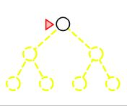
BF-search, an example
Expand shallowest (closest to root) unexpanded node
Implementation: fringe is a FIFO (First In First Out) queue
A
Original Slides by Tom Lenaerts – IRIDIA ULB
Adapted for Edinburgh Napier by Ben Paechter

Slide 39
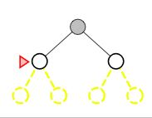
BF-search, an example
Expand shallowest (closest to root) unexpanded node
Implementation: fringe is a FIFO (First In First Out) queue
A
B
C
Original Slides by Tom Lenaerts – IRIDIA ULB
Adapted for Edinburgh Napier by Ben Paechter

Slide 40
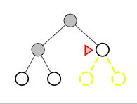
BF-search, an example
Expand shallowest (closest to root) unexpanded node
Implementation: fringe is a FIFO (First In First Out) queue
A
B
C
D
E
Original Slides by Tom Lenaerts – IRIDIA ULB
Adapted for Edinburgh Napier by Ben Paechter

Slide 41
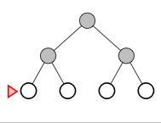
BF-search, an example
Expand shallowest (closest to root) unexpanded node
Implementation: fringe is a FIFO (First In First Out) queue
A
B
C
D
E
F
G
Original Slides by Tom Lenaerts – IRIDIA ULB
Adapted for Edinburgh Napier by Ben Paechter

Slide 42
BF-search; evaluation
Completeness:
  Does it always find a solution if one exists?
  YES
    If shallowest goal node is at some finite depth d
    Condition: If b is finite
      (maximum num. Of succ. nodes is finite)
Original Slides by Tom Lenaerts – IRIDIA ULB
Adapted for Edinburgh Napier by Ben Paechter

Slide 43
BF-search; evaluation
Completeness:
  YES (if b is finite)
Time complexity:
  Assume a state space where every state has b successors.
    root has b successors, each node at the next level has again b successors (total b²), …
    Assume solution is at depth d
    Worst case; expand all but the last node at depth d
    Total numb. of nodes generated:
Original Slides by Tom Lenaerts – IRIDIA ULB
Adapted for Edinburgh Napier by Ben Paechter

Slide 44
BF-search; evaluation
Completeness:
  YES (if b is finite)
Time complexity:
  Total numb. of nodes generated:
Space complexity:
  The same if each node is retained in memory
Original Slides by Tom Lenaerts – IRIDIA ULB
Adapted for Edinburgh Napier by Ben Paechter

Slide 45
BF-search; evaluation
Completeness:
  YES (if b is finite)
Time complexity:
  Total numb. of nodes generated:
Space complexity:
  The same if each node is retained in memory
Optimality:
  Does it always find the least-cost solution?
  YES – if all actions have the same cost
Original Slides by Tom Lenaerts – IRIDIA ULB
Adapted for Edinburgh Napier by Ben Paechter

Slide 46
BF-search; evaluation
Two lessons:
  Memory requirements are a bigger problem than its execution time.
  Exponential complexity search problems cannot be solved by uninformed search methods for any but the smallest instances.
DEPTH2 | NODES | TIME | MEMORY
2 | 1100 | 0.11 seconds | 1 megabyte
4 | 111100 | 11 seconds | 106 megabytes
6 | 10⁷ | 19 minutes | 10 gigabytes
8 | 10⁹ | 31 hours | 1 terabyte
10 | 10¹¹ | 129 days | 101 terabytes
12 | 10¹³ | 35 years | 10 petabytes
14 | 10¹⁵ | 3523 years | 1 exabyte
Original Slides by Tom Lenaerts – IRIDIA ULB
Adapted for Edinburgh Napier by Ben Paechter

Slide 47
Uniform-cost search
Extension of BF-search:
  Expand node with lowest path cost
Implementation: fringe = queue ordered by path cost.
UC-search is the same as BF-search when all step-costs are equal.
Original Slides by Tom Lenaerts – IRIDIA ULB
Adapted for Edinburgh Napier by Ben Paechter

Slide 48
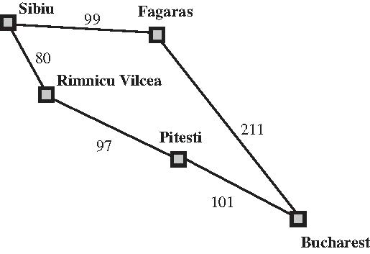
Example: Romania
Original Slides by Tom Lenaerts – IRIDIA ULB
Adapted for Edinburgh Napier by Ben Paechter

Slide 49
Example: Romania
Original Slides by Tom Lenaerts – IRIDIA ULB
Adapted for Edinburgh Napier by Ben Paechter

Slide 50
Example: Romania
Path is 99
Path is 80
Original Slides by Tom Lenaerts – IRIDIA ULB
Adapted for Edinburgh Napier by Ben Paechter

Slide 51
Example: Romania
Path is 99
Path is 80
Original Slides by Tom Lenaerts – IRIDIA ULB
Adapted for Edinburgh Napier by Ben Paechter

Slide 52
Example: Romania
Path is 99
Path is 80
Path is 177
Original Slides by Tom Lenaerts – IRIDIA ULB
Adapted for Edinburgh Napier by Ben Paechter

Slide 53
Example: Romania
Path is 99
Path is 80
Path is 177
Original Slides by Tom Lenaerts – IRIDIA ULB
Adapted for Edinburgh Napier by Ben Paechter

Slide 54
Example: Romania
Path is 99
Path is 80
Path is 177
Path is 310
Original Slides by Tom Lenaerts – IRIDIA ULB
Adapted for Edinburgh Napier by Ben Paechter

Slide 55
Example: Romania
Path is 99
Path is 80
Path is 177
Goal
Path is 310
Original Slides by Tom Lenaerts – IRIDIA ULB
Adapted for Edinburgh Napier by Ben Paechter

Slide 56
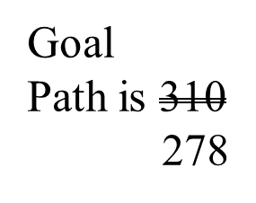
Example: Romania
Path is 99
Path is 80
Path is 177
Original Slides by Tom Lenaerts – IRIDIA ULB
Adapted for Edinburgh Napier by Ben Paechter

Slide 57
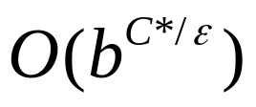
Uniform-cost search
Completeness:
  YES, if step-cost > ε (small positive constant)
Time complexity:
  Assume C* the cost of the optimal solution.
  Assume that every action costs at least ε
  Worst-case:
Space complexity:
  Same as time complexity
Original Slides by Tom Lenaerts – IRIDIA ULB
Adapted for Edinburgh Napier by Ben Paechter

Slide 58
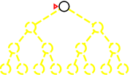
DF-search, an example
Expand deepest unexpanded node
Implementation: fringe is a LIFO queue (=stack)
A
Original Slides by Tom Lenaerts – IRIDIA ULB
Adapted for Edinburgh Napier by Ben Paechter

Slide 59
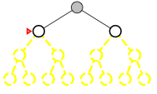
DF-search, an example
Expand deepest unexpanded node
Implementation: fringe is a LIFO queue (=stack)
A
B
C
Original Slides by Tom Lenaerts – IRIDIA ULB
Adapted for Edinburgh Napier by Ben Paechter

Slide 60
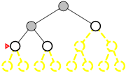
DF-search, an example
Expand deepest unexpanded node
Implementation: fringe is a LIFO queue (=stack)
A
B
C
D
E
Original Slides by Tom Lenaerts – IRIDIA ULB
Adapted for Edinburgh Napier by Ben Paechter

Slide 61
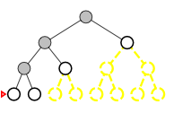
DF-search, an example
Expand deepest unexpanded node
Implementation: fringe is a LIFO queue (=stack)
A
B
C
D
E
H
I
Original Slides by Tom Lenaerts – IRIDIA ULB
Adapted for Edinburgh Napier by Ben Paechter

Slide 62
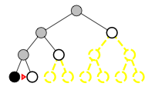
DF-search, an example
Expand deepest unexpanded node
Implementation: fringe is a LIFO queue (=stack)
A
C
B
D
E
H
I
Original Slides by Tom Lenaerts – IRIDIA ULB
Adapted for Edinburgh Napier by Ben Paechter

Slide 63
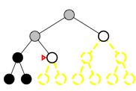
DF-search, an example
Expand deepest unexpanded node
Implementation: fringe is a LIFO queue (=stack)
A
B
C
D
E
H
I
Original Slides by Tom Lenaerts – IRIDIA ULB
Adapted for Edinburgh Napier by Ben Paechter

Slide 64
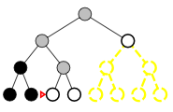
DF-search, an example
Expand deepest unexpanded node
Implementation: fringe is a LIFO queue (=stack)
A
B
C
D
E
H
I
J
K
Original Slides by Tom Lenaerts – IRIDIA ULB
Adapted for Edinburgh Napier by Ben Paechter

Slide 65
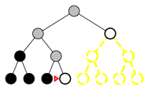
DF-search, an example
Expand deepest unexpanded node
Implementation: fringe is a LIFO queue (=stack)
A
B
C
D
E
H
I
J
K
Original Slides by Tom Lenaerts – IRIDIA ULB
Adapted for Edinburgh Napier by Ben Paechter

Slide 66
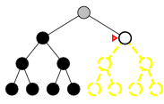
DF-search, an example
Expand deepest unexpanded node
Implementation: fringe is a LIFO queue (=stack)
A
B
C
D
E
H
I
J
K
Original Slides by Tom Lenaerts – IRIDIA ULB
Adapted for Edinburgh Napier by Ben Paechter

Slide 67
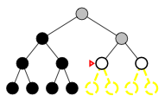
DF-search, an example
Expand deepest unexpanded node
Implementation: fringe is a LIFO queue (=stack)
A
B
C
D
E
F
H
H
I
J
K
Original Slides by Tom Lenaerts – IRIDIA ULB
Adapted for Edinburgh Napier by Ben Paechter

Slide 68
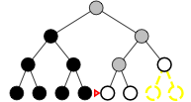
DF-search, an example
Expand deepest unexpanded node
Implementation: fringe is a LIFO queue (=stack)
A
B
C
D
E
F
H
H
I
J
K
L
M
Original Slides by Tom Lenaerts – IRIDIA ULB
Adapted for Edinburgh Napier by Ben Paechter

Slide 69
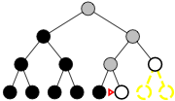
DF-search, an example
Expand deepest unexpanded node
Implementation: fringe is a LIFO queue (=stack)
A
B
C
D
E
F
H
H
I
J
K
L
M
Original Slides by Tom Lenaerts – IRIDIA ULB
Adapted for Edinburgh Napier by Ben Paechter

Slide 70
DF-search; evaluation
Completeness;
  Does it always find a solution if one exists?
  NO
    unless search space is finite and no loops are possible.
Original Slides by Tom Lenaerts – IRIDIA ULB
Adapted for Edinburgh Napier by Ben Paechter

Slide 71

DF-search; evaluation
Completeness;
  NO unless search space is finite.
Time complexity;
  Terrible if m is much larger than d
  But if many solutions, then faster than BF-search
  b - maximum branching factor of the search tree
  d - depth of the least-cost solution
  m - maximum depth of the state space (may be ∞)
Original Slides by Tom Lenaerts – IRIDIA ULB
Adapted for Edinburgh Napier by Ben Paechter

Slide 72

DF-search; evaluation
Completeness;
  NO unless search space is finite.
Time complexity;
Space complexity;
  Backtracking search uses even less memory
    One successor instead of all b.
  b - maximum branching factor of the search tree
  d - depth of the least-cost solution
  m - maximum depth of the state space (may be ∞)
Original Slides by Tom Lenaerts – IRIDIA ULB
Adapted for Edinburgh Napier by Ben Paechter

Slide 73
DF-search; evaluation
Completeness;
  NO unless search space is finite.
Time complexity;
Space complexity;
Optimality; No
  Same issues as completeness
  Assume node J and C contain goal states
Original Slides by Tom Lenaerts – IRIDIA ULB
Adapted for Edinburgh Napier by Ben Paechter

Slide 74


Depth-limited search
Is DF-search with depth limit l.
  i.e. nodes at depth l have no successors.
  Problem knowledge can be used
Solves the infinite-path problem.
If l < d then incompleteness results.
If l > d then not optimal.
Time complexity:
Space complexity:
Original Slides by Tom Lenaerts – IRIDIA ULB
Adapted for Edinburgh Napier by Ben Paechter

Slide 75
Iterative deepening search
What?
  A general strategy to find best depth limit l.
    Goals is found at depth d, the depth of the shallowest goal-node.
  Often used in combination with DF-search
Combines benefits of DF- en BF-search
Original Slides by Tom Lenaerts – IRIDIA ULB
Adapted for Edinburgh Napier by Ben Paechter

Slide 76
ID-search, example
Limit=0
Original Slides by Tom Lenaerts – IRIDIA ULB
Adapted for Edinburgh Napier by Ben Paechter

Slide 77
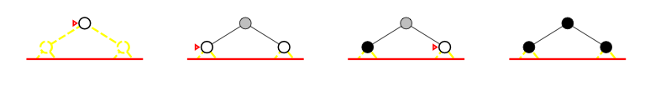
ID-search, example
Limit=1
Original Slides by Tom Lenaerts – IRIDIA ULB
Adapted for Edinburgh Napier by Ben Paechter

Slide 78
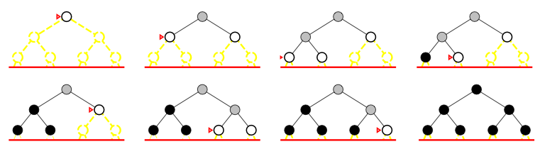
ID-search, example
Limit=2
Original Slides by Tom Lenaerts – IRIDIA ULB
Adapted for Edinburgh Napier by Ben Paechter

Slide 79
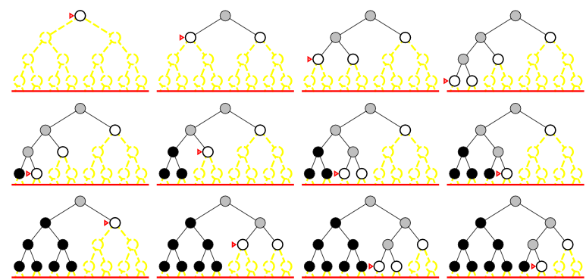
ID-search, example
Limit=3
Original Slides by Tom Lenaerts – IRIDIA ULB
Adapted for Edinburgh Napier by Ben Paechter

Slide 80
ID search, evaluation
Completeness:
  YES (no infinite paths)
Original Slides by Tom Lenaerts – IRIDIA ULB
Adapted for Edinburgh Napier by Ben Paechter

Slide 81


ID search, evaluation
Completeness:
  YES (no infinite paths)
Time complexity:
Space complexity:
  Cfr. depth-first search
Original Slides by Tom Lenaerts – IRIDIA ULB
Adapted for Edinburgh Napier by Ben Paechter

Slide 82
ID search, evaluation
Completeness:
  YES (no infinite paths)
Time complexity:
Space complexity:
Optimality:
  YES if step cost is 1.
  Can be extended to iterative lengthening search
    Same idea as uniform-cost search
    Increases overhead.
Original Slides by Tom Lenaerts – IRIDIA ULB
Adapted for Edinburgh Napier by Ben Paechter

Slide 83
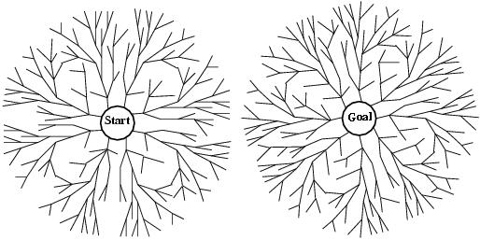

Bidirectional search
Two simultaneous searches from start an goal.
  Motivation:
Check whether the node belongs to the other fringe before expansion.
Space complexity is the most significant weakness.
Complete and optimal if both searches are BF.
Original Slides by Tom Lenaerts – IRIDIA ULB
Adapted for Edinburgh Napier by Ben Paechter

Slide 84
How to search backwards?
The predecessor of each node should be efficiently computable.
  When actions are easily reversible.
Original Slides by Tom Lenaerts – IRIDIA ULB
Adapted for Edinburgh Napier by Ben Paechter

Slide 85
Summary of algorithms
Criterion | Breadth-First | Uniform-cost | Depth-First | Depth-limited | Iterative deepening | Bidirectional search
Complete? | YES* | YES* | NO | YES, if l ≥ d | YES | YES*
Time | b^{d+1} | b^{C*/e} | b^{m} | b^{l} | b^{d} | b^{d/2}
Space | b^{d+1} | b^{C*/e} | bm | bl | bd | b^{d/2}
Optimal? | YES* | YES* | NO | NO | YES | YES
Original Slides by Tom Lenaerts – IRIDIA ULB
Adapted for Edinburgh Napier by Ben Paechter

